Slide 1
Global Asset Allocation

Slide 2
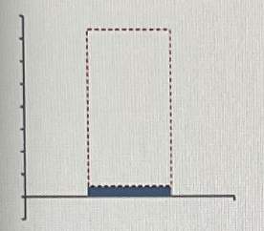
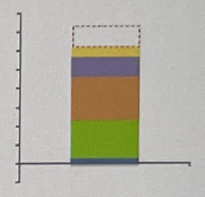
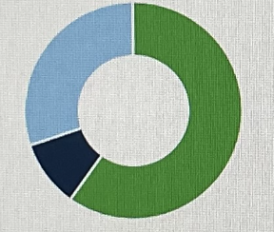
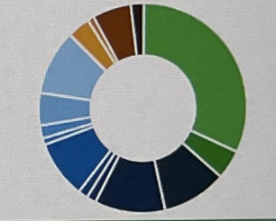
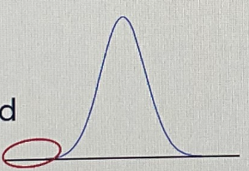
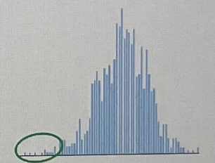
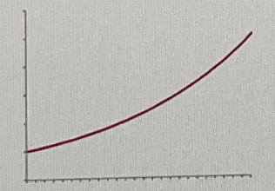
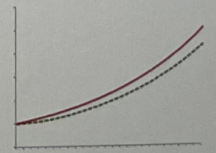
The Advantages of Multi-Factor Approach to Asset Allocation
Traditional Methods
Modern Enhancements
Limited Understanding of Complex Investment Universe and poor risk and return estimates
Multi-Factor Model enhances risk premium prediction by 2x
Optimization Methodology Produced Unreliable Results.
Robust Optimization: Superior Portfolio’s without subjective constraints
Risk Analytics Underestimate True Downside
Factor-Based Risk Analytics generates reliable estimates of downside risk.
Wealth Projections fail to capture true market dynamics
Factor-Based Risk Analytics generates reliable estimates of downside risk.

Slide 3
Factor Models Identify Sources of Long-Term Return
Empowering Investors to Understand and Manage the Sources of Portfolio Performance
Multi-Factor Modelling Enhances Our Understanding Of Return Drivers
Single Factor Models Fail to Capture the Complex Investment Universe
Multi-Strategy Hedge Funds
Emerging Markets Local Debt
Buyout Private Equity
Multi-Factor Risk Premia Estimates
Multi-Factor Doubles the Precision in Risk Premia Estimates
Multi-Strategy Hedge Funds
Emerging Markets Local Debt
Private Equity

Slide 4
Better Understanding of Diversification
Leading to More Resilient Asset Allocations
Portfolio A
Portfolio B
Asset Class Diversification Can Be Misleading
Factors Help Understand True Source of Diversification
In the median case, the SAA portfolio would be expected to grow to around $373, in nominal terms, representing $74 additional growth over the reference portfolio over the 20-year horizon.

Slide 5
Portfolio Risk and Return Analysis (USD Investor)
Forward Looking Portfolio Risk and Return Analytics

Slide 6
Portfolio Risk Decomposition
Forward Looking Portfolio Risk and Return Analytics
Risk Decomposition by Asset Class
Risk Decomposition by FX Exposure
Portfolio Risk Under Various Currency Hedging Scenarios
Concentrated Positions lead to portfolio fragility

Slide 7
Portfolio Factor Decomposition
Forward Looking Portfolio Risk and Return Analytics
Return Decomposition by Factor
Risk Decomposition by Factor
Concentrated positions make portfolios more susceptible to shocks. Close to 50% of the portfolio volatility is driven by exposure to US equities.

Slide 8
Portfolio Wealth Simulation
Currency: USD. No Inflows or Outflows
Portfolio Wealth Illustrations – Evolution of Nominal Portfolio Value Paths
SAA Portfolio Median Case (+74mn)
Reference Portfolio Median Case
In the median case, the SAA portfolio would be expected to grow to around $373, in nominal terms, representing $74 additional growth over the reference portfolio over the 20-year horizon.
In the very bad case, the portfolio would still be expected to grow in nominal terms.

Slide 9
Portfolio Wealth Simulation
Currency: USD. No Inflows or Outflows
Portfolio Wealth Illustrations – Distribution of Portfolio Returns by Inflation Quintile

Slide 10
Portfolio Capital Preservation
Currency: USD. 5.5 Million Yearly Spend
Portfolio Wealth Illustrations
Portfolio Value Paths, Adjusted for Inflation
Yearly Real Outflow Quantiles
With a spend of $5.5mm per year, some amount of real capital destruction would be expected
In the very bad case, the portfolio could experience full capital depletion within the 20-year investment horizon.

Slide 11
Probability of Wealth Preservation
Portfolio Wealth Illustrations – Probability of Real Wealth Preservation Across Spending Levels
With a spend of $5.5mm per year, some amount of real capital destruction would be expected
In the very bad case, the portfolio could experience full capital depletion within the 20-year investment horizon.

Slide 12
Portfolio Yield
Forward Looking Portfolio Risk and Return Analytics

Slide 13
Portfolio Optimizations
Forward Looking Portfolio Risk and Return Analytics

Slide 14
Concentrated Equity Positions
Forward Looking Portfolio Risk and Return Analytics

Slide 15
Diversifying Concentrated Equity Positions
Forward Looking Portfolio Risk and Return Analytics

Slide 16
Optimizing Around Leverage
Forward Looking Portfolio Risk and Return Analytics

Slide 17
Analyzing the Impact of Structured Notes
Forward Looking Portfolio Risk and Return Analytics

Slide 18
Parking Uncalled Capital
Forward Looking Portfolio Risk and Return Analytics

